Slide 1
Quick Recap
Your meetings, summarized in seconds.
By : Team 2 Bros of Balayya

Slide 2
Agenda
Problem Statement
Project Description
Persona
MVP
Technologies & Algorithm
Project Schedule
Teamwork Agreement
Diagrams
Sprint 2 Recap
Product Backlog
Sprint Summaries
Burndown Charts
Sprint Retrospective
Project Demo

Slide 3
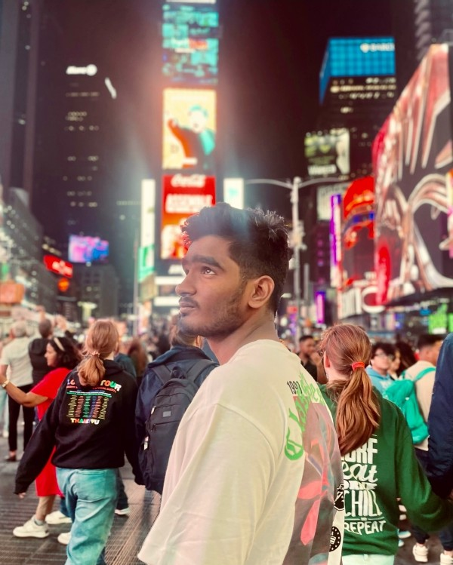

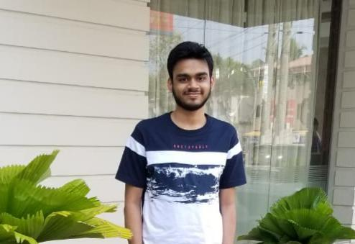
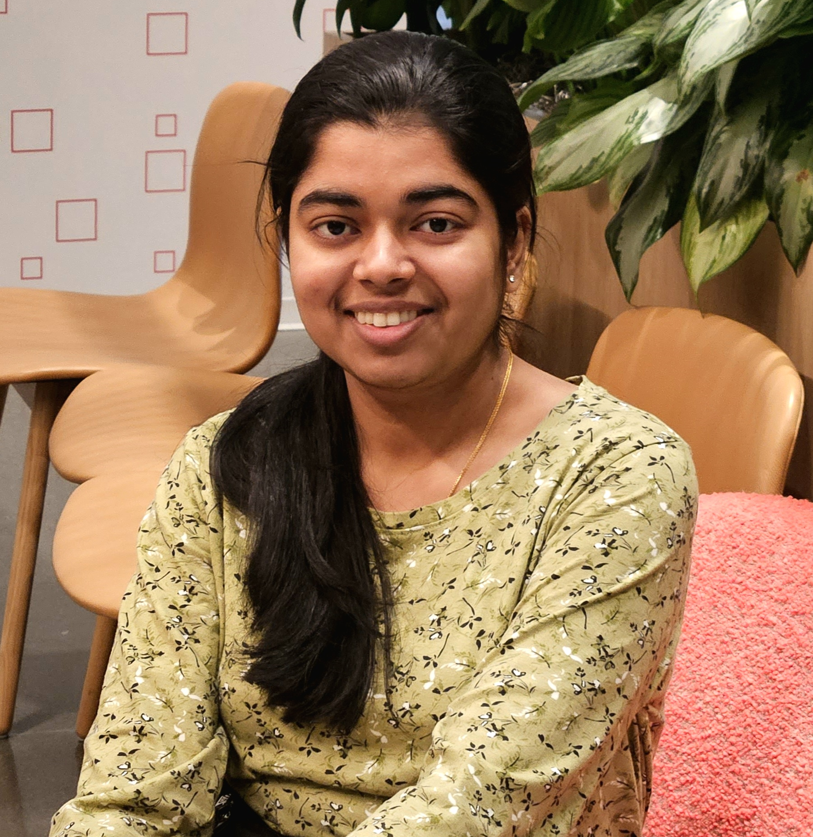
Roles & Responsibilities
Naveen Nayak Team Lead/ Backend Engineer
Navya Nayak ML Engineer/ Scrum Master
Madhu Kiran Frontend Engineer

Slide 4
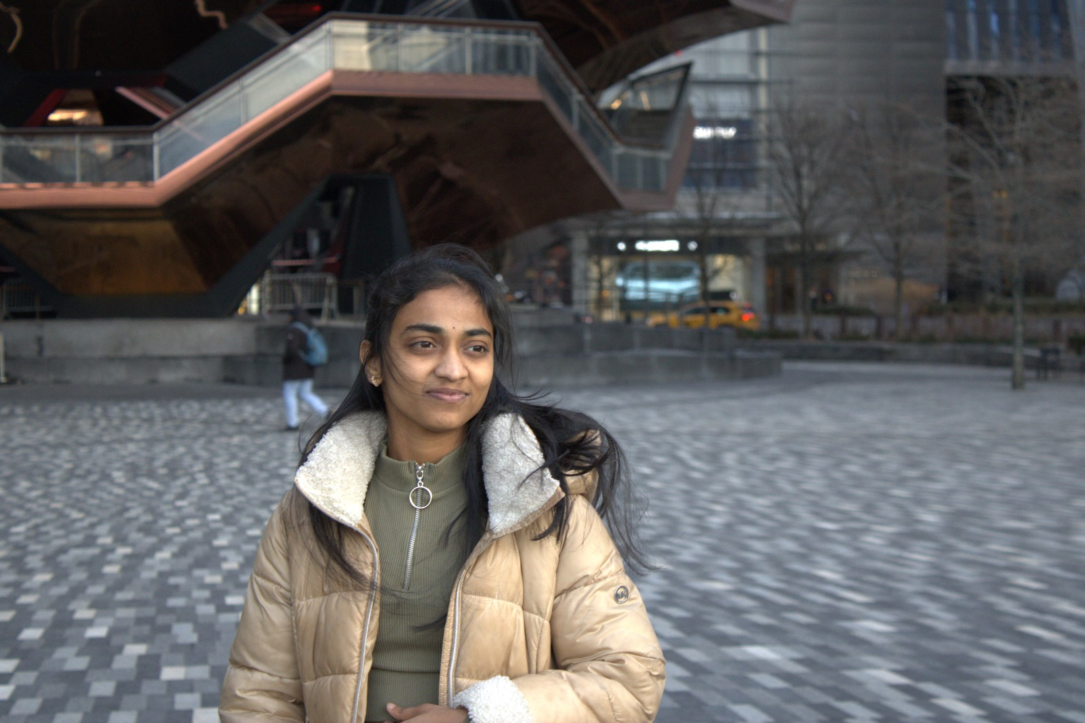
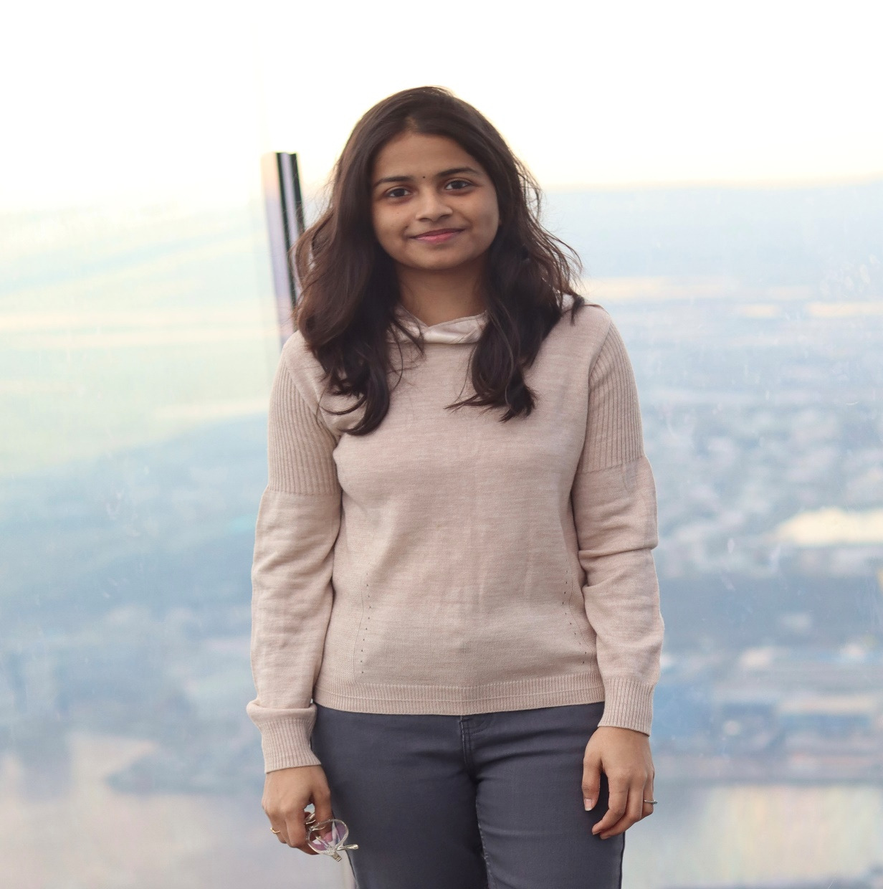
Roles & Responsibilities
Saranya Chandu ML Engineer
Aakruthi Reddy Frontend Engineer

Slide 5

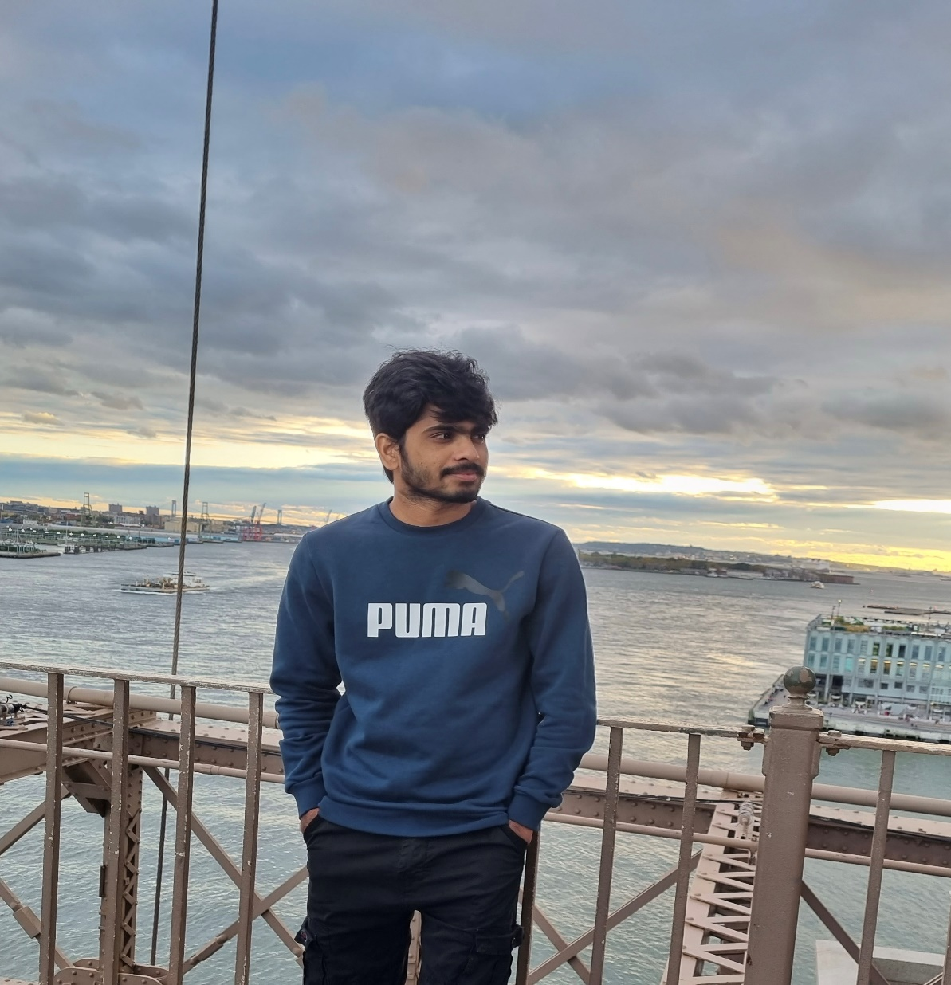
Roles & Responsibilities
Brunai Developer
Vishwas Mamidi Developer/ QA

Slide 6
Improvements made from Feedback
Explained User Story in Detail, Burndown Chart : A detailed walkthrough of each user story, its acceptance criteria, and its progress in the burndown chart.
All sprint deliverables are submitted to the correct links and wiki page is updated.

Slide 7
Meetings are essential, but reviewing recordings and notes is time-consuming and often inefficient. Quick Recap solves this problem by providing personalized, AI-powered summaries of meetings, saving users time and maximizing the value of meeting content.
Problem Statement

Slide 8
Project Description
Web application for enhanced meeting productivity.
Provides personalized summaries of meeting recordings.
Employs natural language processing (NLP) for summary generation.
Highlights the most relevant information based on user profiles.
Enables users to quickly grasp key takeaways without reviewing lengthy recordings.

Slide 9

Persona – Project Manager
Isabelle is a high-level executive at a fast-growing tech company. She's intelligent, driven, and constantly juggling multiple projects and responsibilities.
Challenges:
Attends numerous meetings daily, often back-to-back.
Struggles to recall key decisions, action items, and strategic discussions from past meetings.
Lacks time to review lengthy meeting recordings or detailed notes.
Goals:
Quickly identify action items and delegate tasks effectively.
Make informed decisions based on accurate and concise meeting information.
Reclaim valuable time spent reviewing meeting content.
Name: Isabelle
Age: 48
Gender: Female
Occupation: Project Manager

Slide 10

Persona - Journalist
Lena is an investigative journalist who conducts numerous interviews for her stories. She needs to accurately transcribe and analyze these interviews to extract key information and build her narratives.
Challenges:
Spends countless hours transcribing interviews, which takes away from her research and writing time.
Requires accurate transcriptions to ensure the integrity of her reporting.
Finds it difficult to organize and manage a large number of interview recordings.
Goals:
Quickly and accurately transcribe interviews.
Improve her research and writing workflow..
Efficiently extract key quotes and information.
Name: Lena
Age: 28
Gender: Female
Occupation: Journalist

Slide 11
Persona - Student
Carlos is a highly motivated university student pursuing a demanding degree in engineering. He's dedicated to his studies but often finds himself overwhelmed by the volume of information presented in lectures and seminars.
Challenges:
Struggles to keep up with the fast pace of lectures and take comprehensive notes.
Finds it difficult to identify the most important concepts and takeaways from lectures.
Needs a more efficient way to organize and review lecture material.
Goals:
Easily find specific information discussed in lectures.
Create concise and organized notes from lectures without having to rewatch everything.
Improve his overall learning efficiency and academic performance.
Name: Carlos
Age: 22
Gender: Male
Occupation: Engineering Student

Slide 12
Upload audio/video files
Automatic transcription via speech-to-text
Basic user profiles (role, interests)
Personalized summaries based on user profiles
Core summarization algorithm
User-friendly web interface.
MVP Product

Slide 13






Technologies
REACT
JavaScript
Python
Firebase
Jira
GitHub

Slide 14





Workflow
Upload
Speech to text
Personalization
Summarization
Display

Slide 15
Project Schedule
Sprint 0 Feb 11
Sprint 1 Mar 11
Sprint 2 Apr 8
Sprint 3 May 05
Sprint 0 | Sprint 1 | Sprint 2 | Sprint 3
Daliy Scrum call | Daliy Scrum call | Daliy Scrum call | Daliy Scrum call
Sprint Retrospective | Sprint Planning | Sprint Planning | Sprint Planning
 | Sprint Retrospective | Sprint Retrospective | Sprint Retrospective
 | Product development (Frontend, ML model, Backend) | Product development (Integration of components) | Final Product development

Slide 16
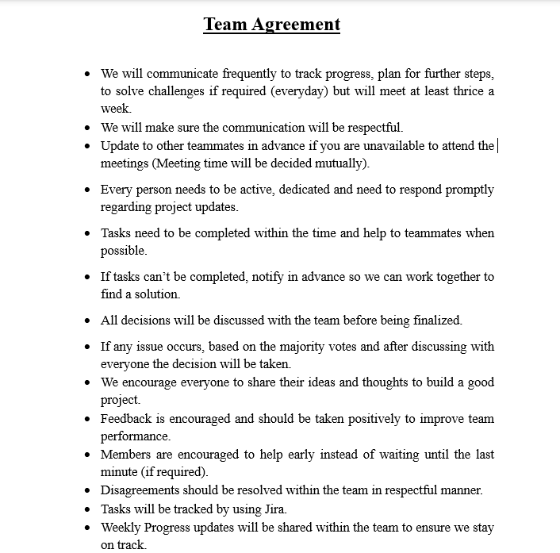
Team Working Agreement

Slide 17
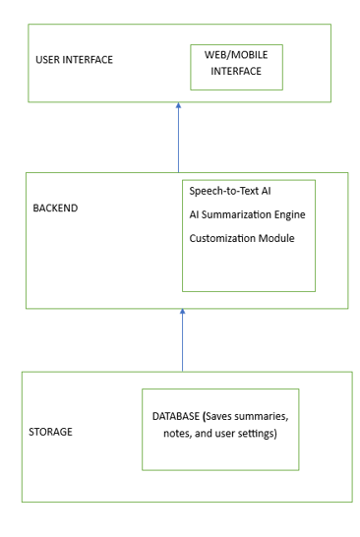
Architecture Diagram

Slide 18
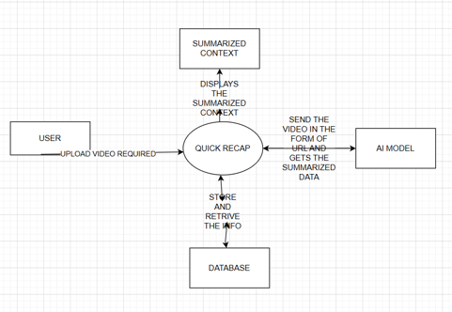
Context Diagram

Slide 19
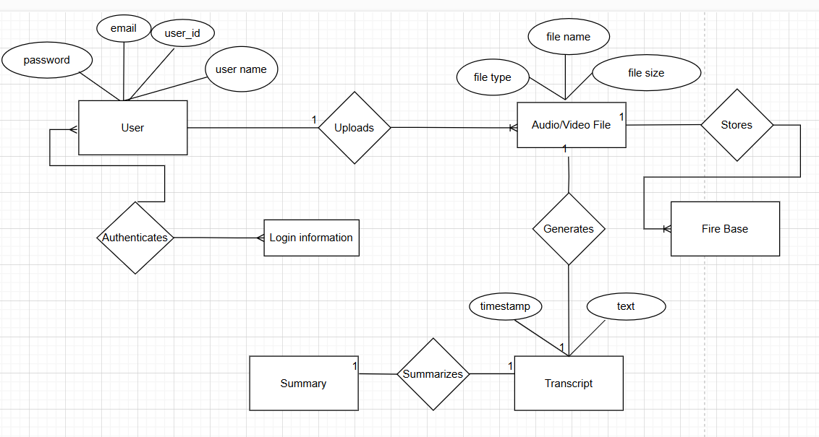
ER Diagram

Slide 20
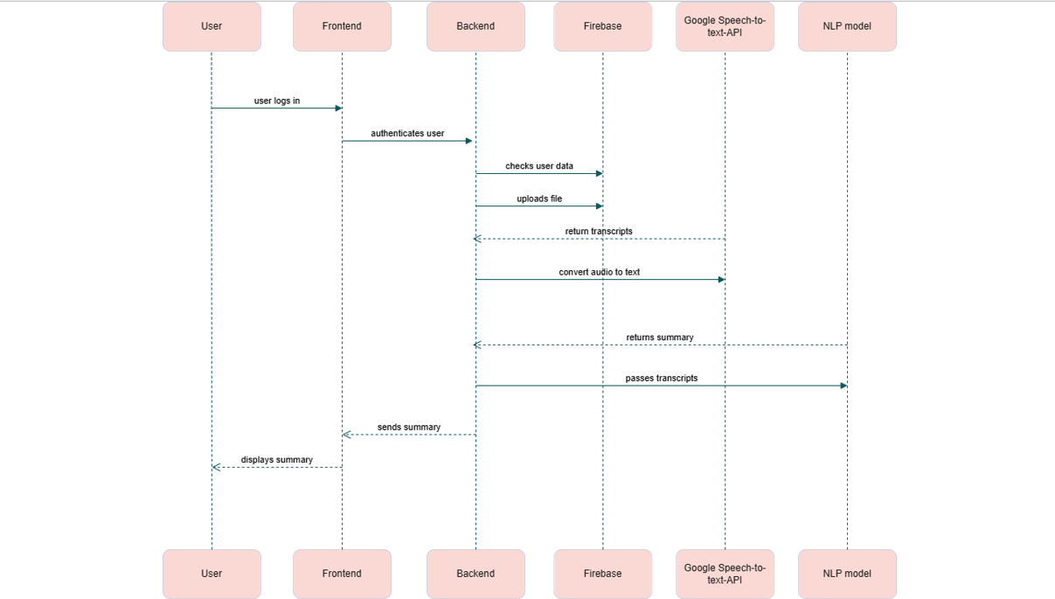
Sequence Diagram

Slide 21
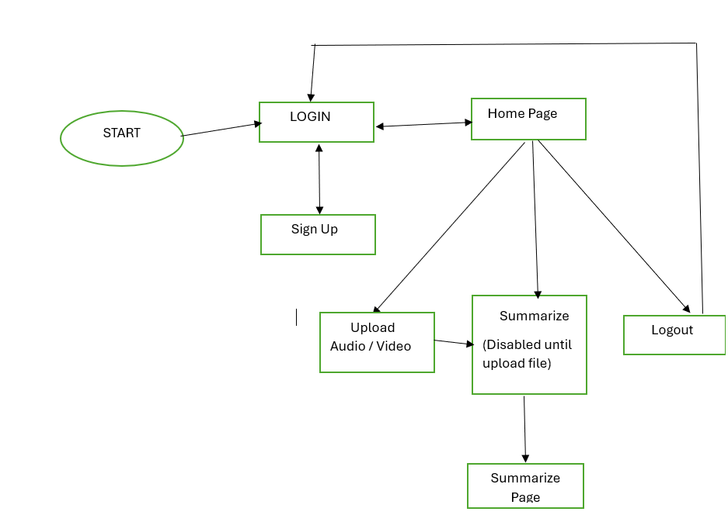
State Diagram

Slide 22
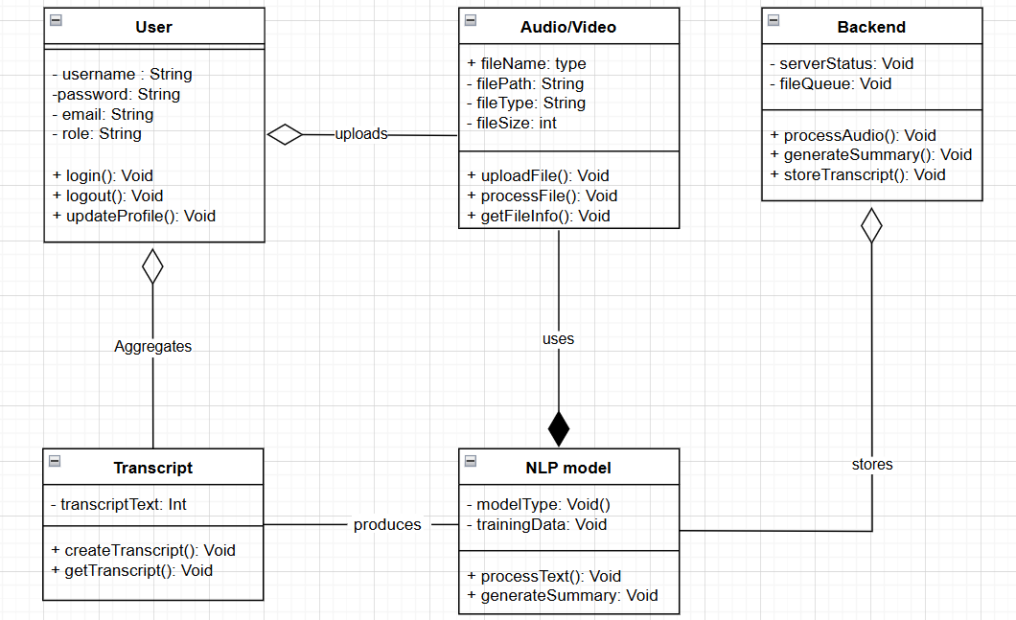
Class Diagram

Slide 23
Sprint 2 Recap
Audio Transcription : Developed and tested automatic transcription of uploaded audio files into text.
Video preview feature was implemented in this sprint.
Implemented summary generation for audio and video transcription.
Improved User Interface.

Slide 24
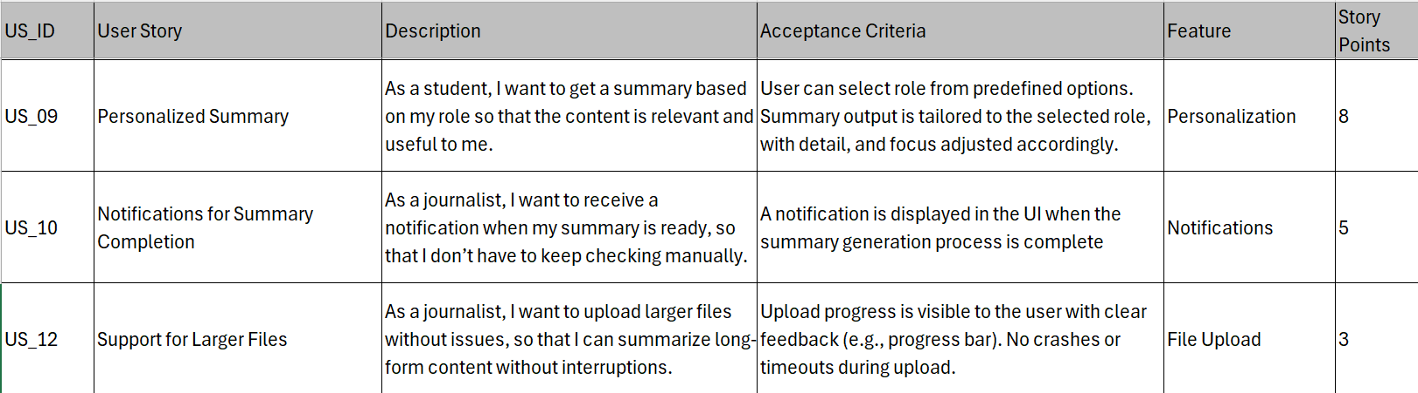
Product Backlog

Slide 25
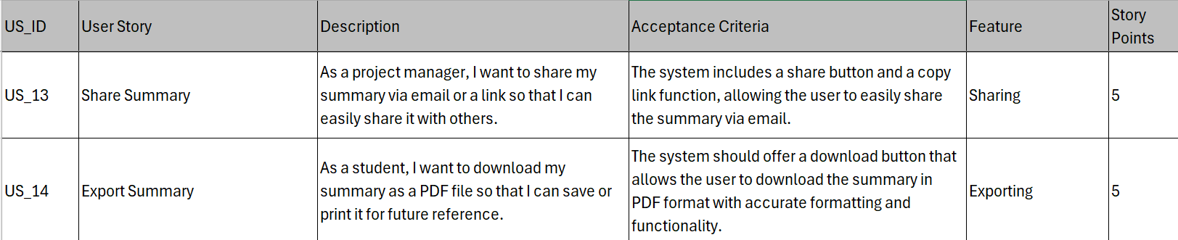
Product Backlog

Slide 26
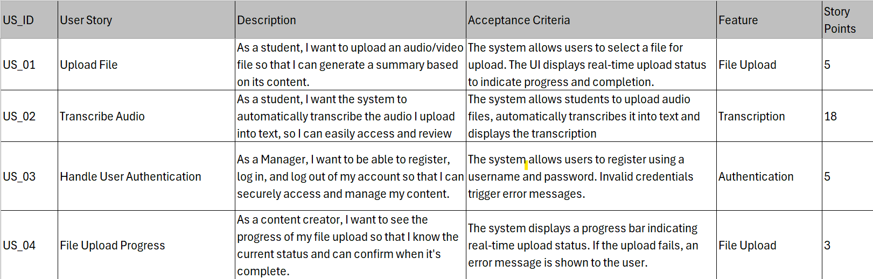
Sprint 1 Summary
Sprint 1 User Stories

Slide 27
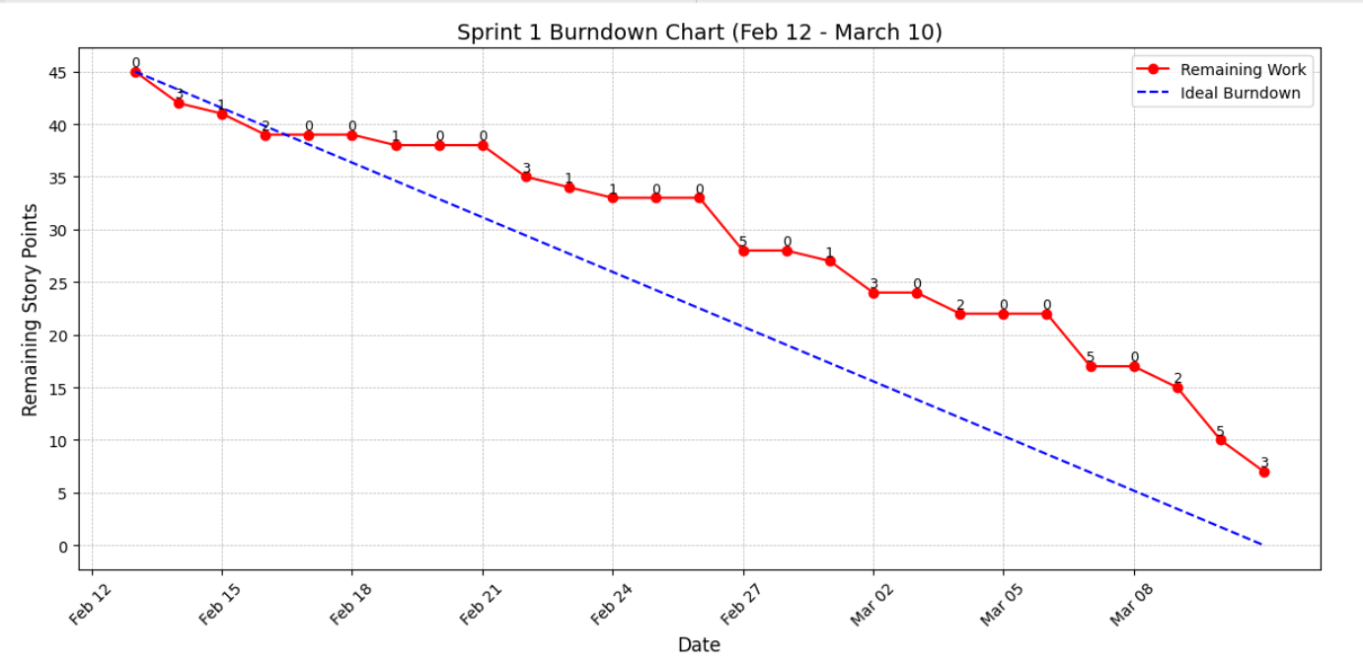
Sprint 1 Summary
Sprint 1 Burndown Chart

Slide 28
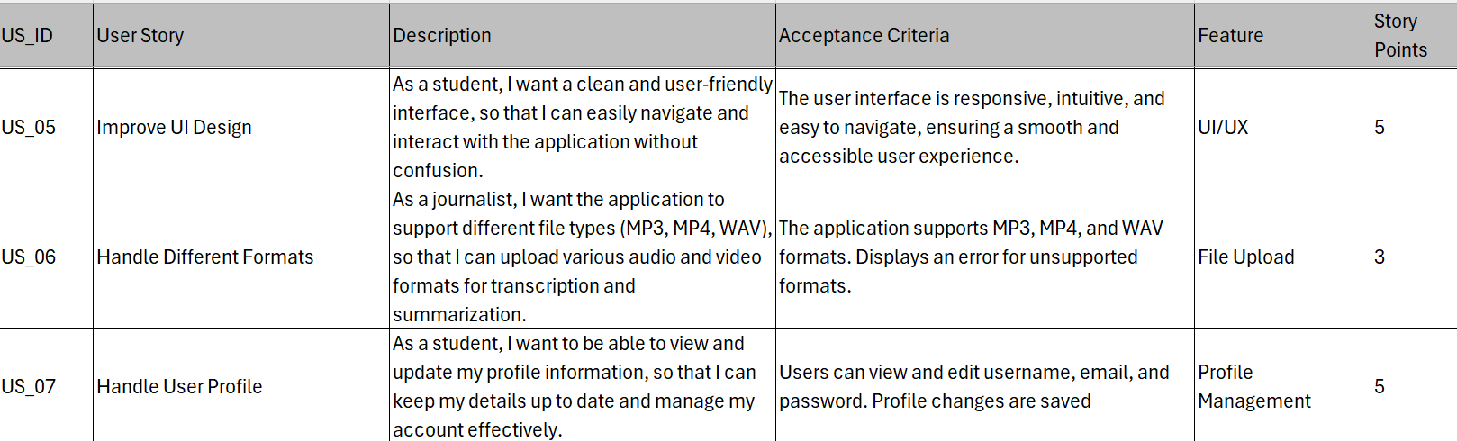
Sprint 2 Summary
Sprint 2 User Stories

Slide 29
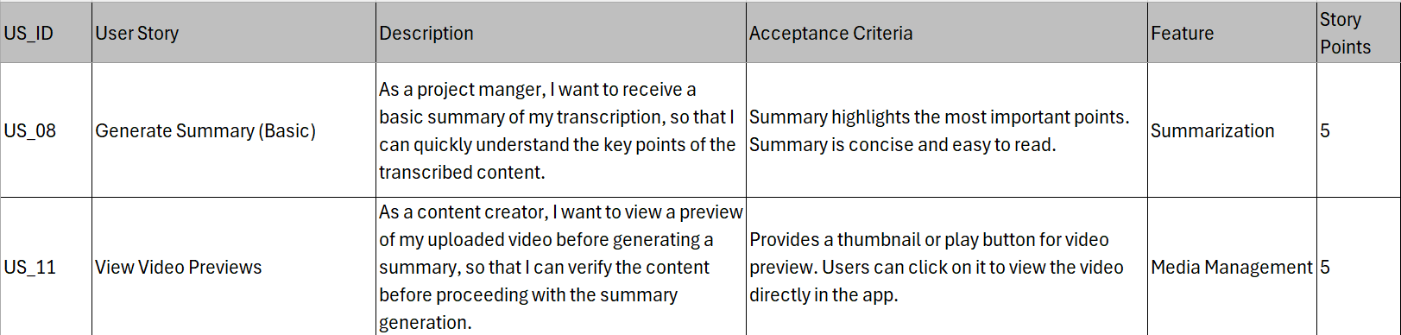
Sprint 2 Summary
Sprint 2 User Stories

Slide 30
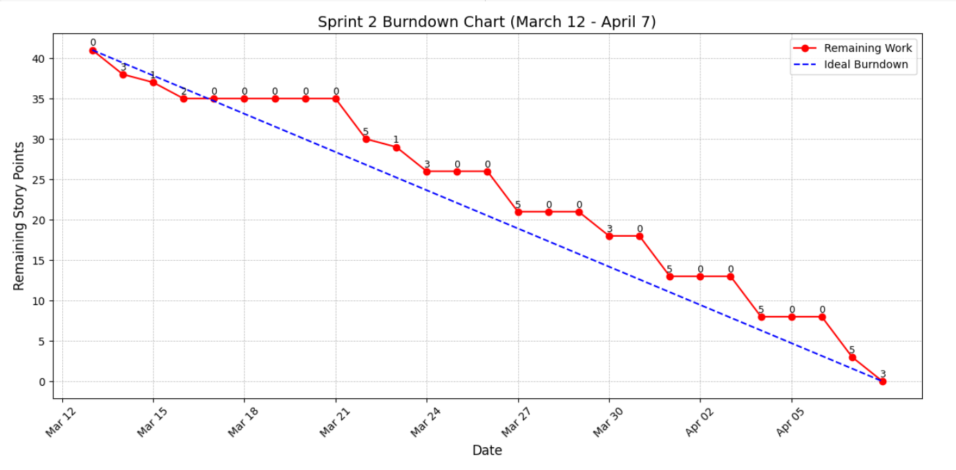
Sprint 2 Summary
Sprint 2 Burndown Chart

Slide 31
Sprint 3 User Stories

Slide 32
Sprint 3 User Stories

Slide 33
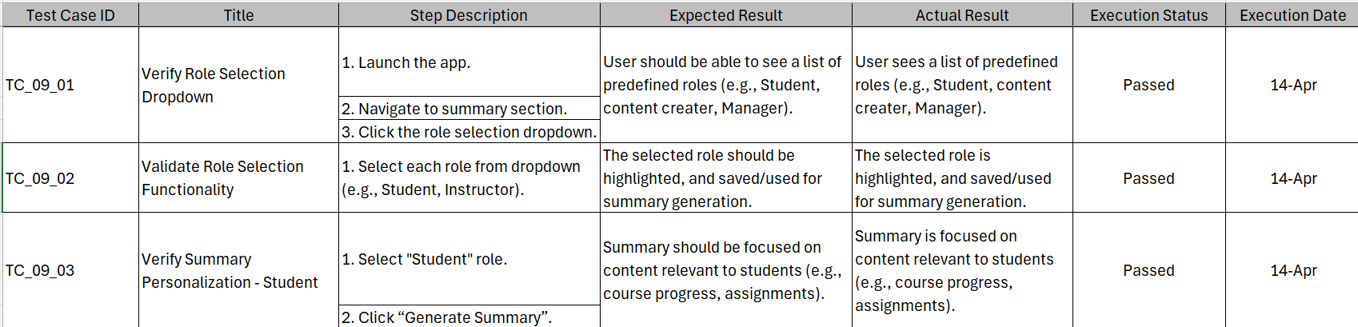
Test Cases
User Story 9 : Personalized Summary

Slide 34
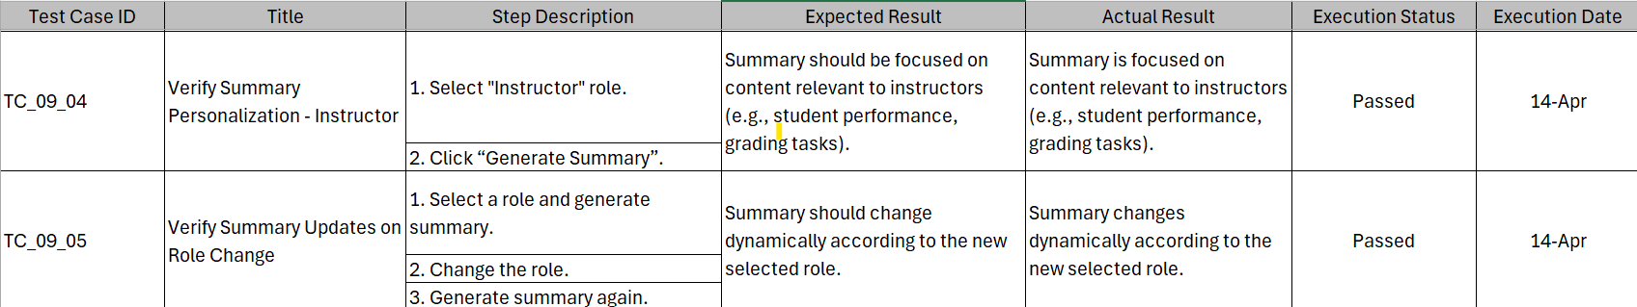
Test Cases
User Story 9 : Personalized Summary

Slide 35
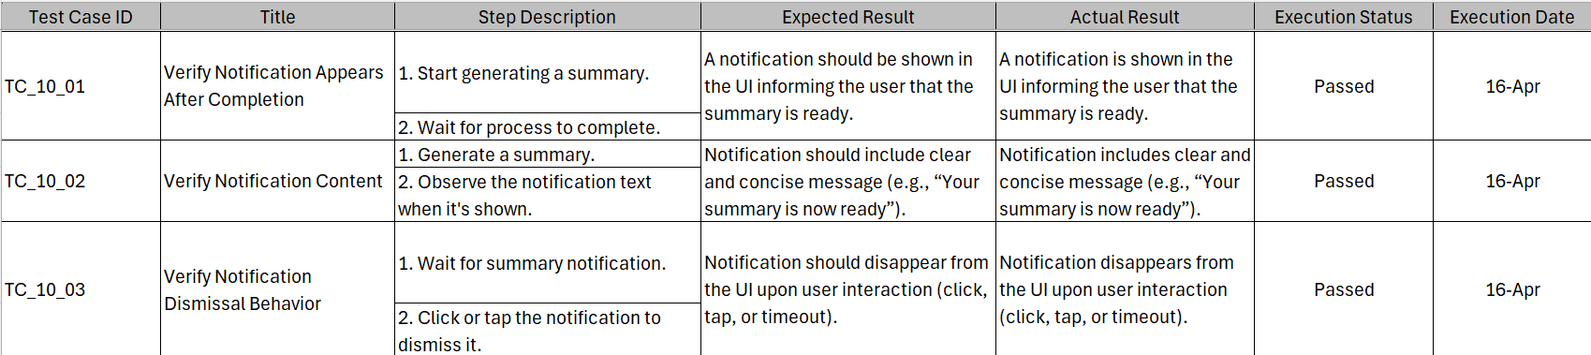
Test Cases
User Story 10 : Notifications for Summary Completion

Slide 36
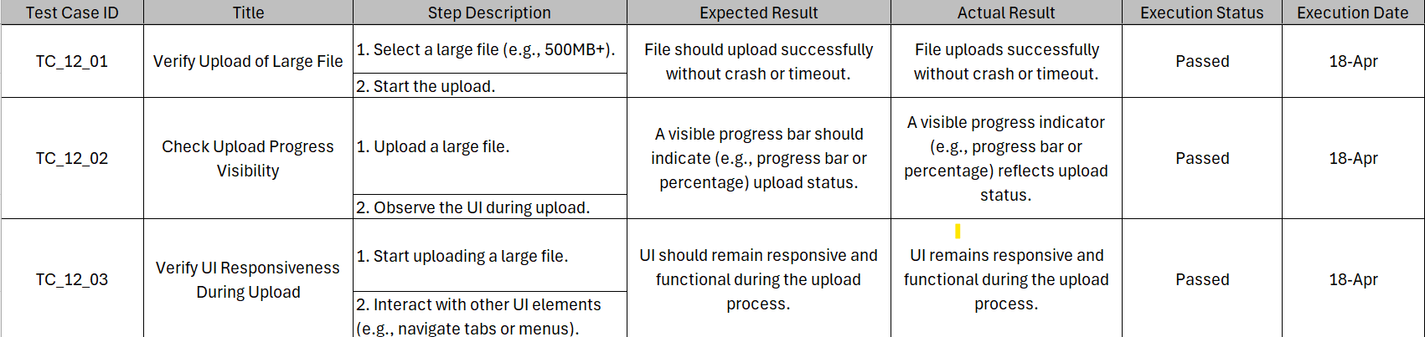
Test Cases
User Story 12 : Support for Larger Files

Slide 37
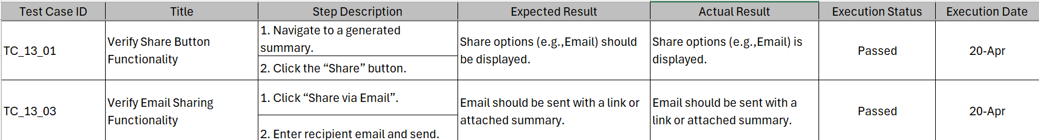
Test Cases
User Story 13 : Share Summary

Slide 38
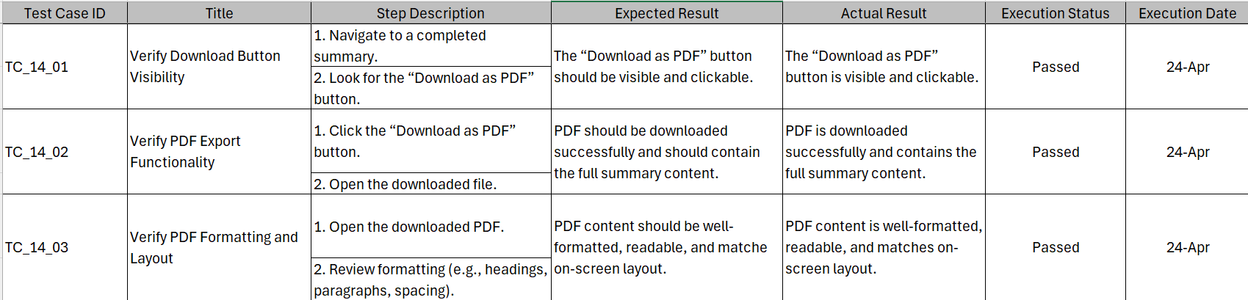
Test Cases
User Story 14 : Export Summary

Slide 39
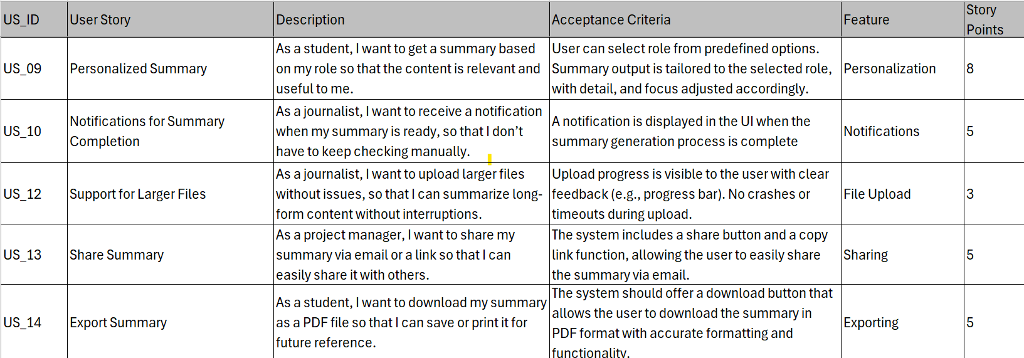
Sprint 3 Stories Completed / Not Completed
User Stories Completed

Slide 40
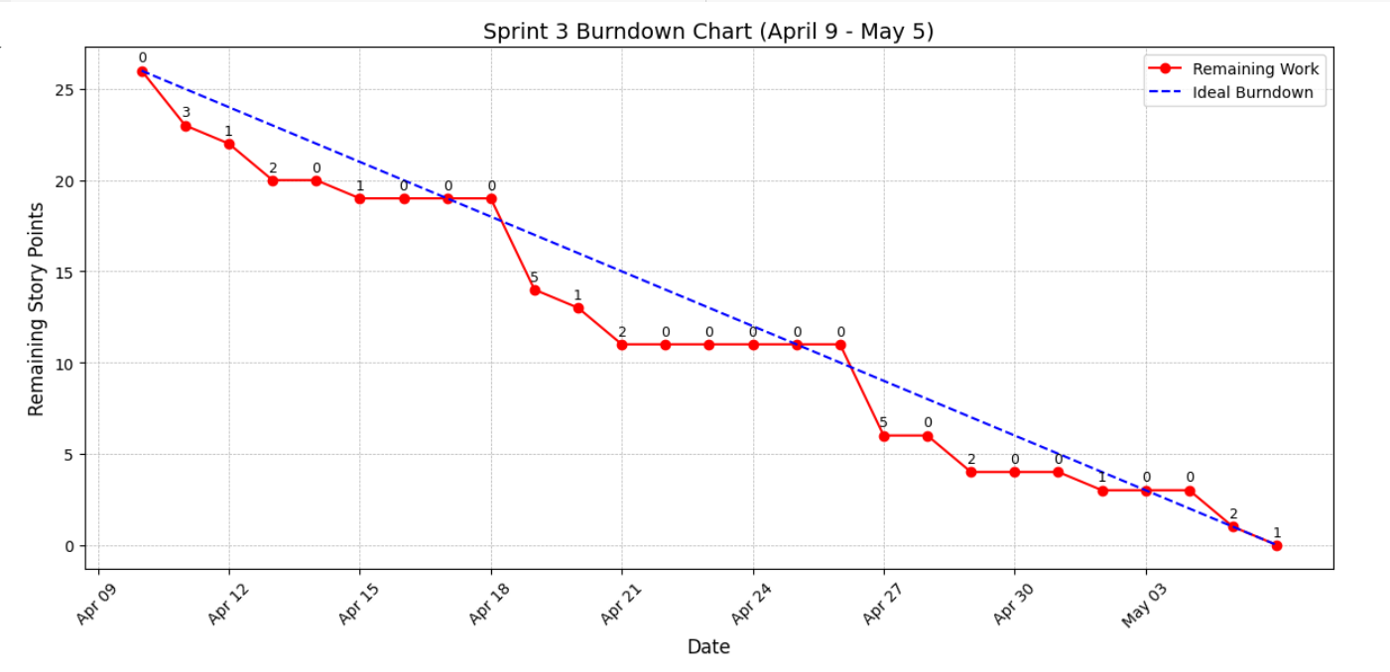
Metrics – Burndown Chart

Slide 41
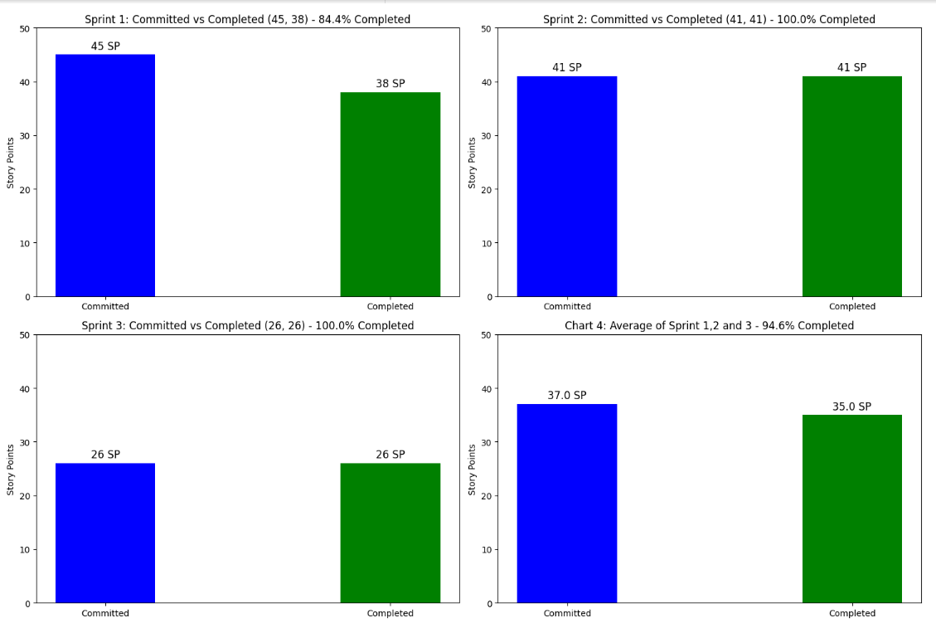
Metrics – Team velocity and Completed / Committed Ratio

Slide 42
Sprint 3 - Retrospective
What went well?
Good communication among team members
Successfully implemented the key features
Feedback / action items from previous sprint was worked on

Slide 43
Sprint 3 - Retrospective
What can be improved?
Jira needs to be updated more frequently
Communicate regularly and take others help more often. Address issues immediately as they arise
Ensure that all the sprint deliverables are accessible and updated.

Slide 44
Sprint 3 - Retrospective
Action items
Assigned to everyone : Update jira as and when there is any progress for the tasks.
Assigned to everyone : Ensure all sprint deliverables are submitted to the correct links and wiki page is updated.

Slide 45
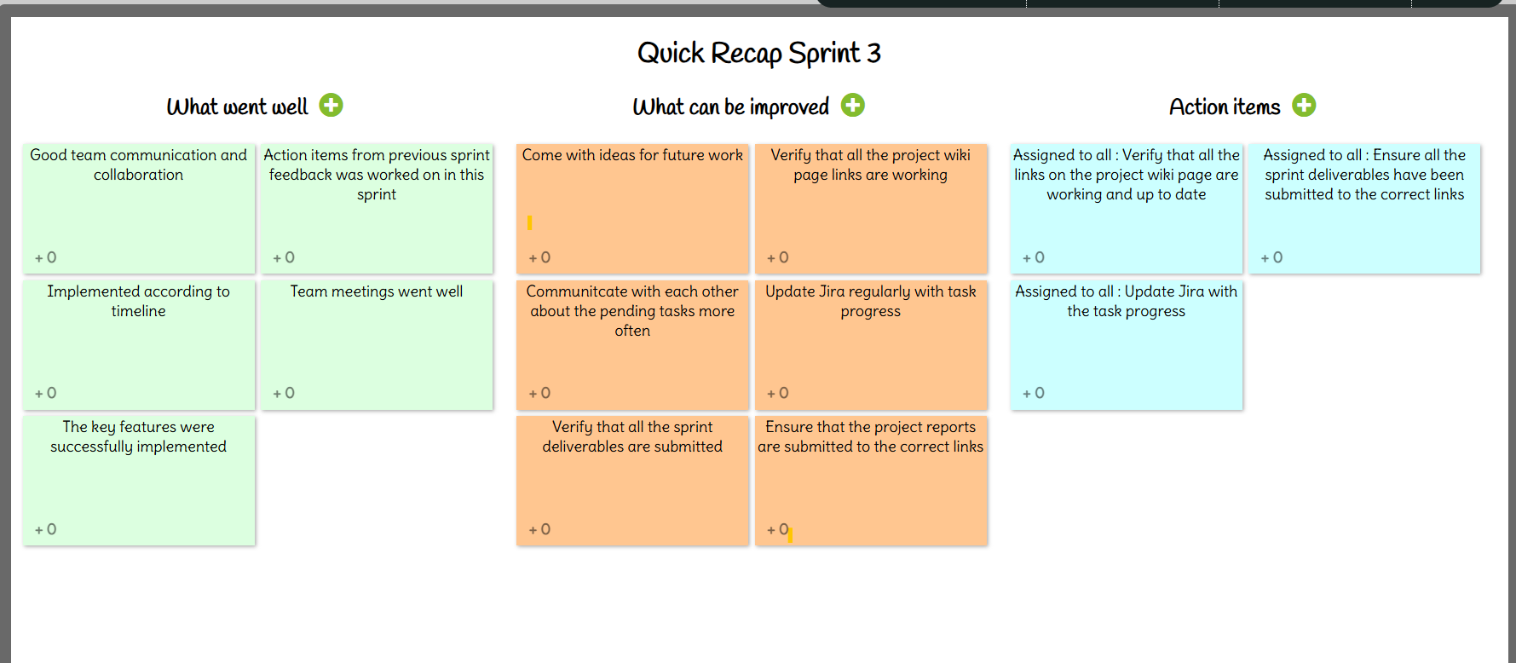
Sprint 3 - Retrospective

Slide 46
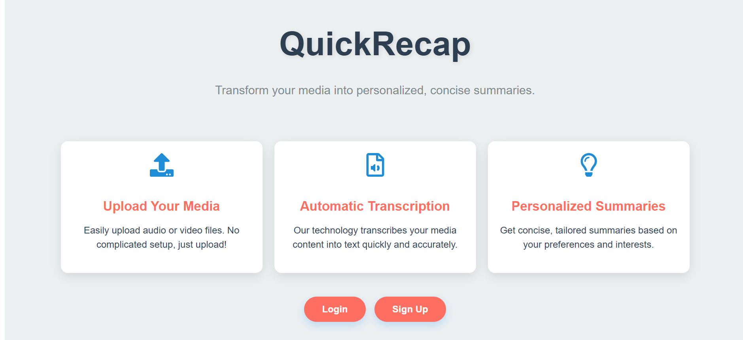
Sprint 3 - Project Demo

Slide 47
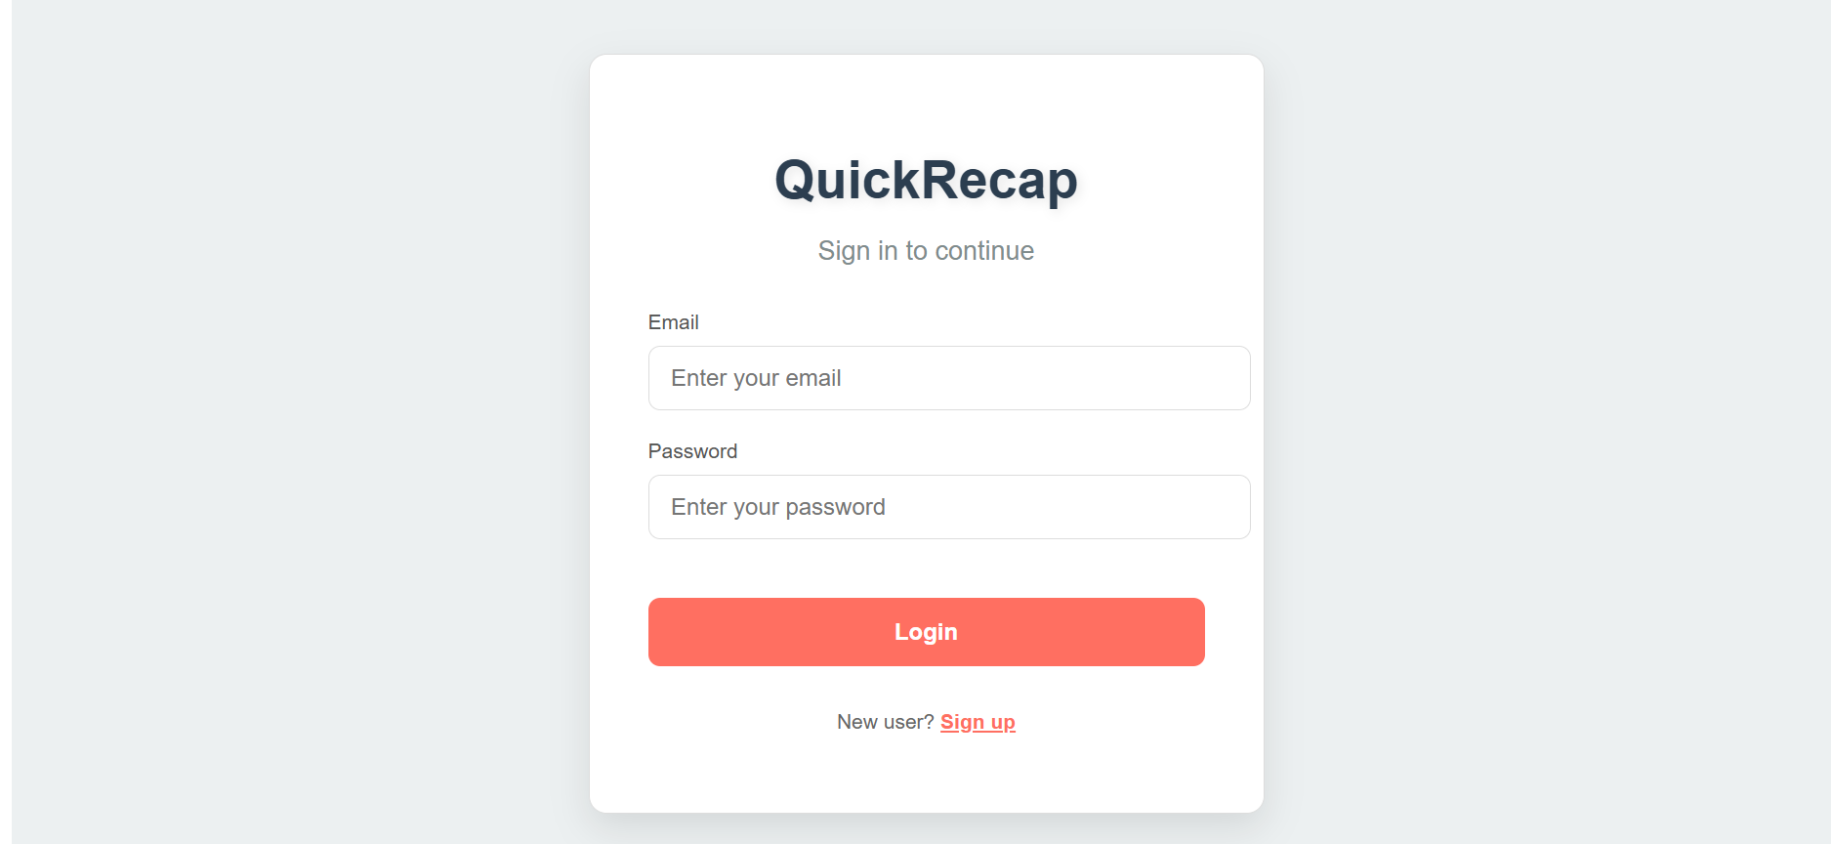
Sprint 3 - Project Demo

Slide 48
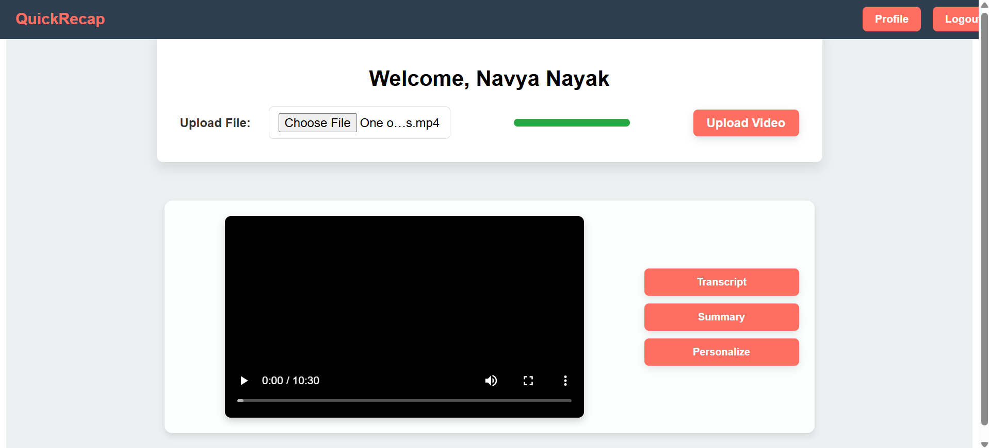
Sprint 3 - Project Demo

Slide 49
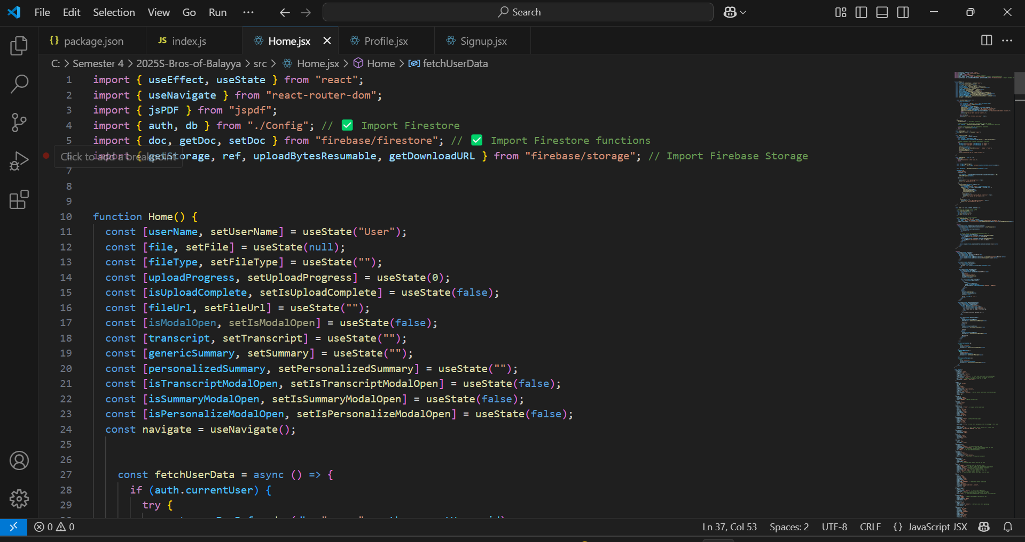
Sprint 3 - Project Demo

Slide 50
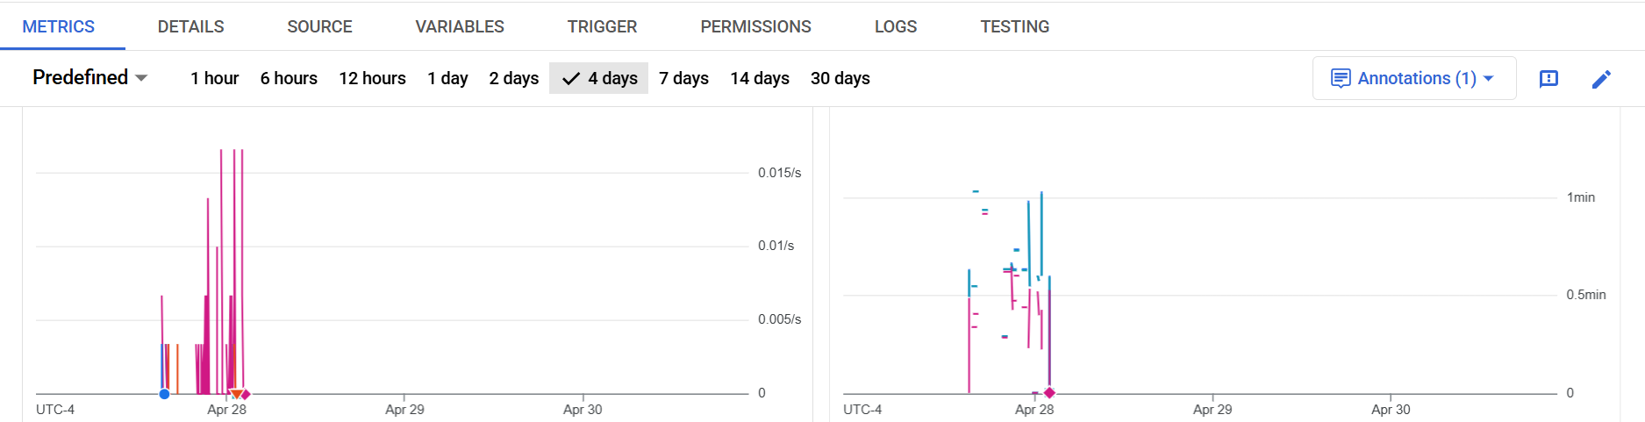
Sprint 3 - Project Demo

Slide 51
Wiki page Link
To see our progress visit the wiki page below:
https://github.com/htmw/2025S-Bros-of-Balayya/wiki

Slide 52
Live project demo
Project Demo YouTube link :
https://www.youtube.com/watch?v=8LH5HwnJs1I

Slide 53
Thank You

